Slide 1
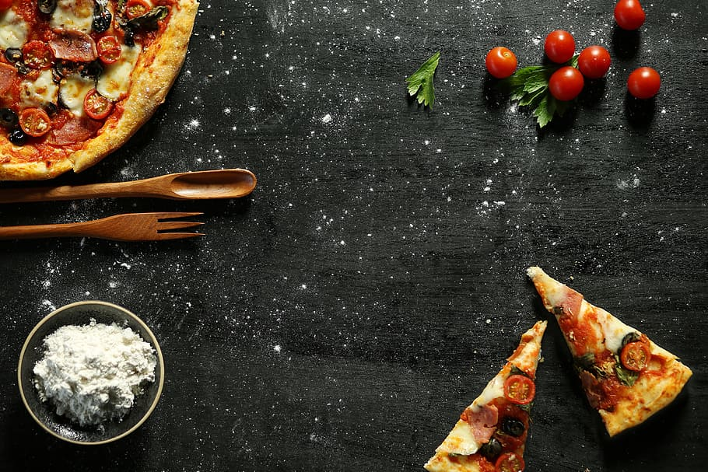
PRESENTATION
Pizza Sales Analysis
SANTANU DUTTA

Slide 2


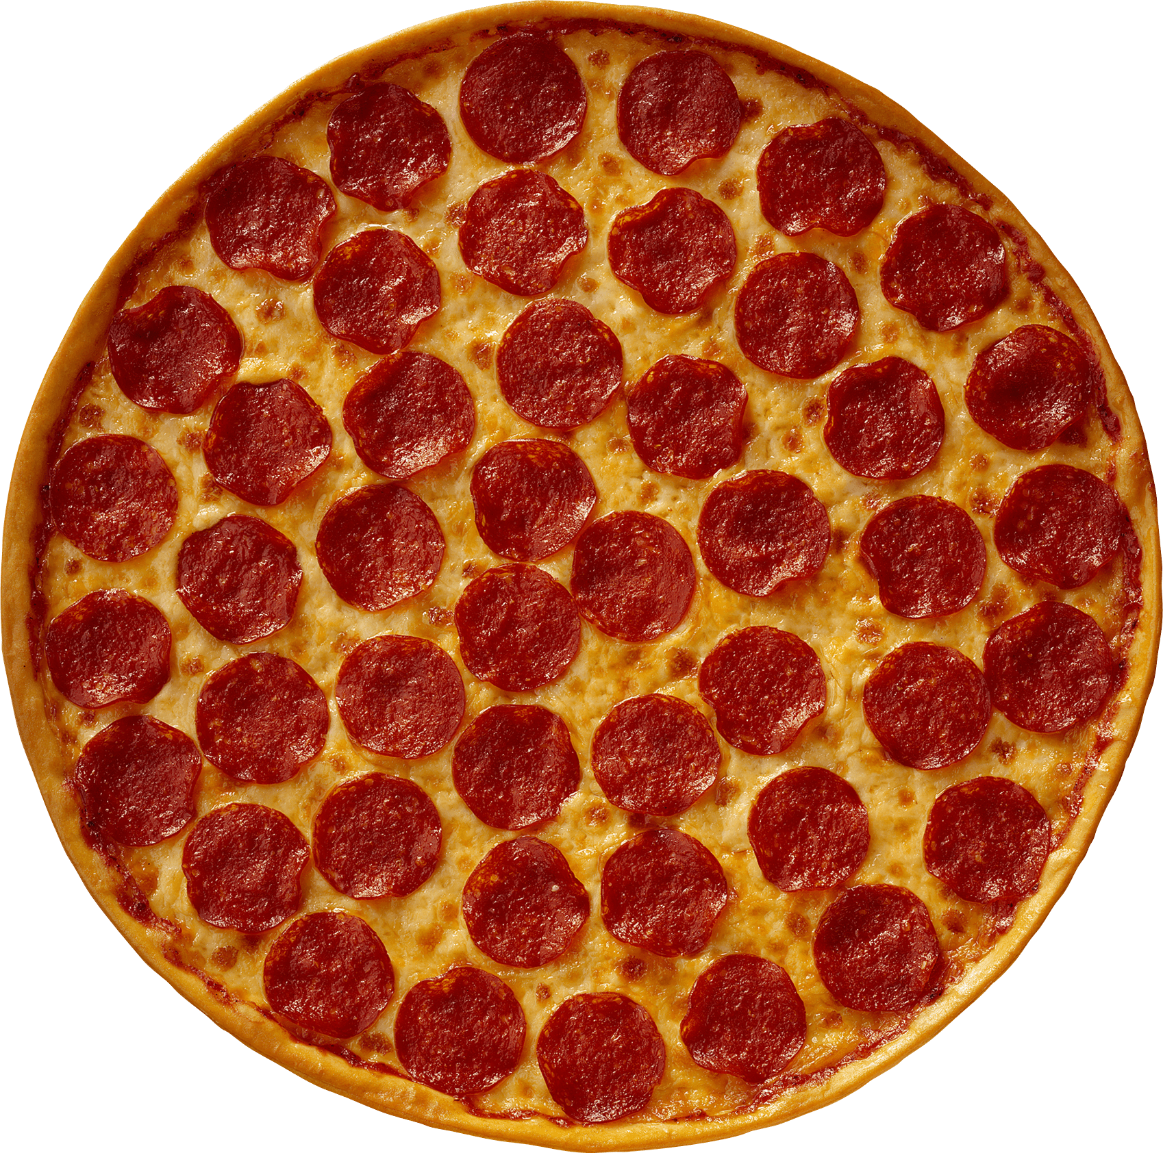
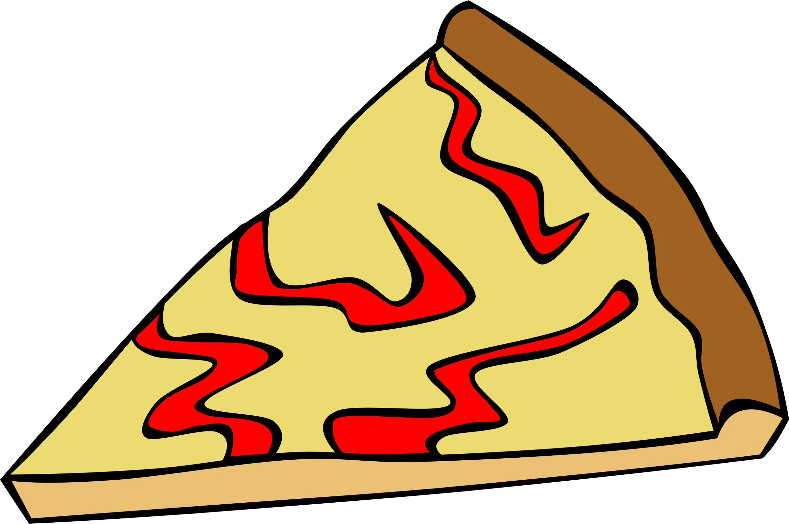
INTRODUCTION
Welcome to the Pizza Sales Analysis project. The pizza business is growing, but to continue this success, we need to understand the sales data in depth. This project explores critical aspects of operations, such as total orders, revenue, pizza types, and customer behavior. By answering basic, intermediate, and advanced questions, the goal is to uncover insights that can guide business strategies.
In this project, key trends will be identified, revealing what drives revenue and which pizzas are most popular with customers. Let's take a closer look at the data to explore ways to improve the business and ensure sustained growth.
This Photo by Unknown Author is licensed under CC BY-NC

Slide 3

Question mode
1
EASY
2
INTERMEDIATE
3
ADVANCE

Slide 4

QUESTIONS
Basic:
1.Retrieve the total number of orders placed.
2.Calculate the total revenue generated from pizza sales.
3.Identify the highest-priced pizza.
4.Identify the most common pizza size ordered.
5.List the top 5 most ordered pizza types along with their quantities.
Intermediate:
6.Join the necessary tables to find the total quantity of each pizza category ordered.
7.Determine the distribution of orders by hour of the day.
8.Join relevant tables to find the category-wise distribution of pizzas.
9.Group the orders by date and calculate the average number of pizzas ordered per day.
10.Determine the top 3 most ordered pizza types based on revenue.
Advanced:
11.Calculate the percentage contribution of each pizza type to total revenue.
12.Analyze the cumulative revenue generated over time.
13.Determine the top 3 most ordered pizza types based on revenue for each pizza category.

Slide 5
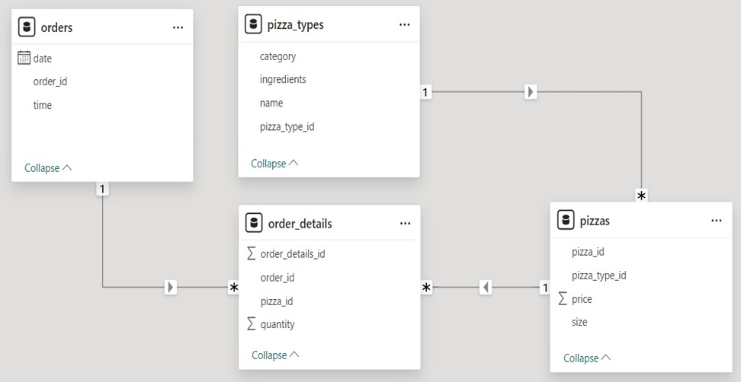


SCHEMA
PIZZA SALES DATABASE

Slide 6
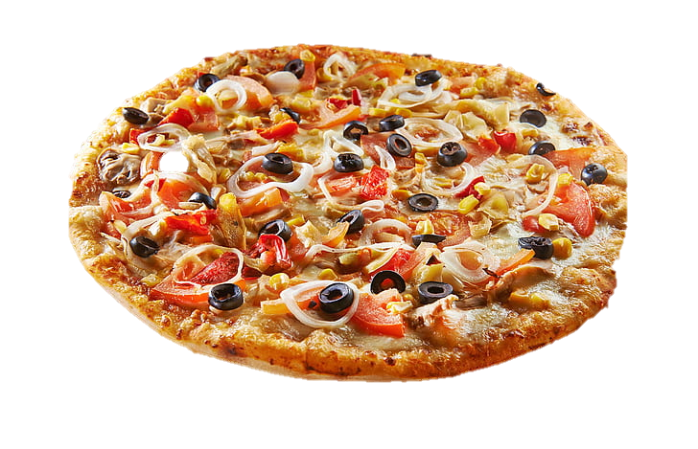
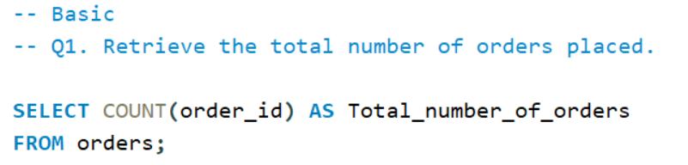

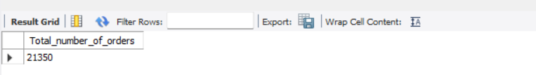
Q1. Retrieve the total number of orders placed.
QUERY
OUTPUT

Slide 7
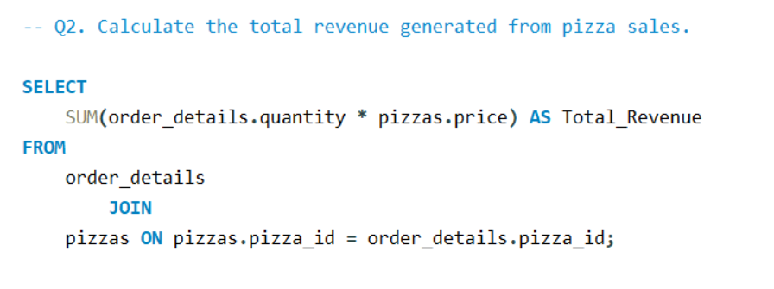
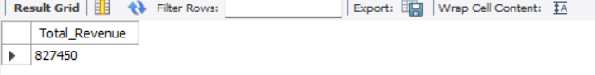
Q2. Calculate the total revenue generated from pizza sales.
QUERY
OUTPUT

Slide 8
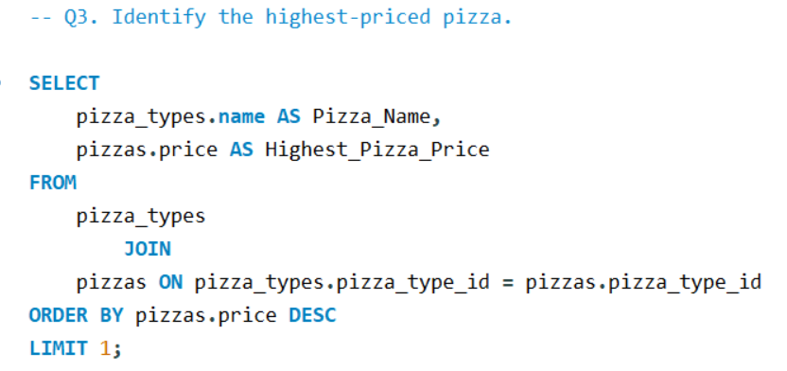
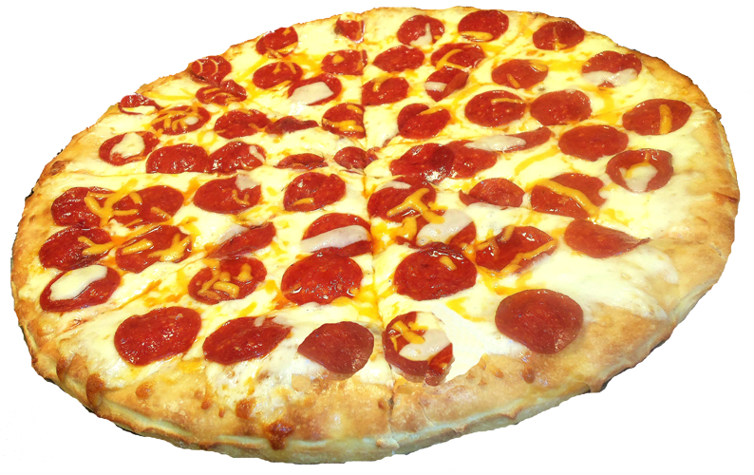
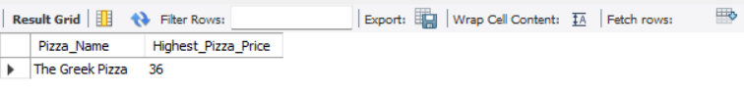
Q3. Identify the highest-priced pizza.
QUERY
OUTPUT

Slide 9
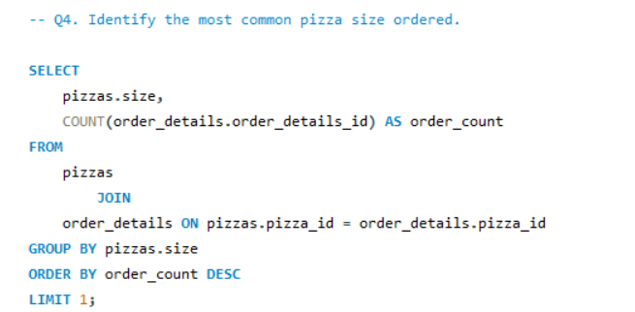
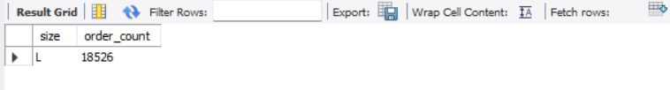
Q4. Identify the most common pizza size ordered.
INPUT
OUTPUT

Slide 10
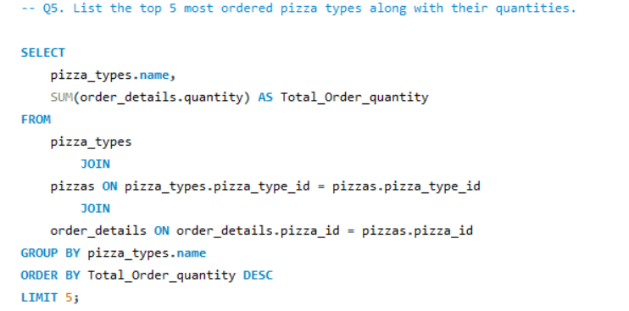
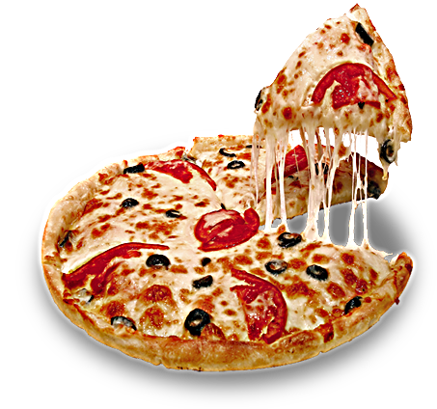
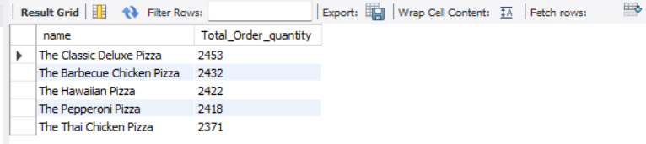
Q5. List the top 5 most ordered pizza types along with their quantities.
QUERY
OUTPUT

Slide 11
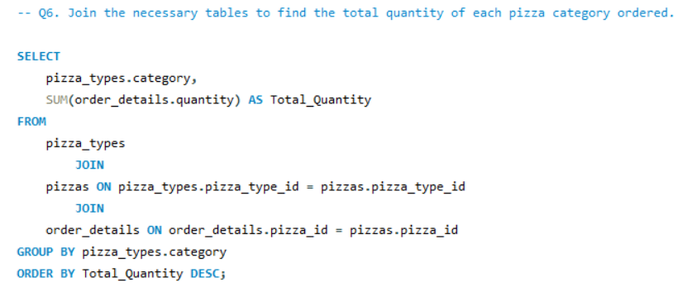
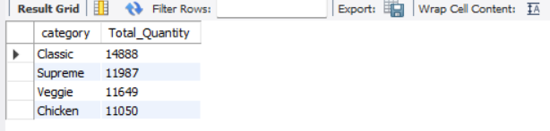
Q6. Join the necessary tables to find the total quantity of each pizza category ordered.
QUERY
OUTPUT

Slide 12
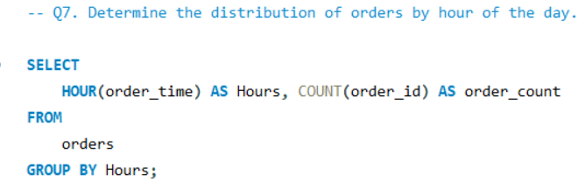
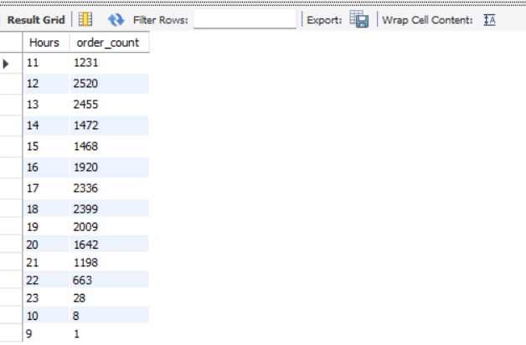
Q7. Determine the distribution of orders by hour of the day.
QUERY
OUTPUT

Slide 13
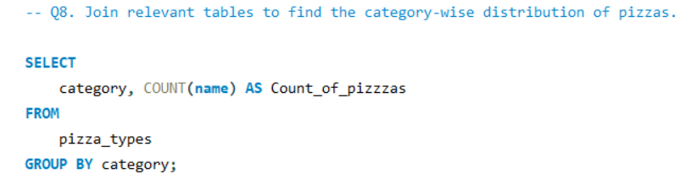
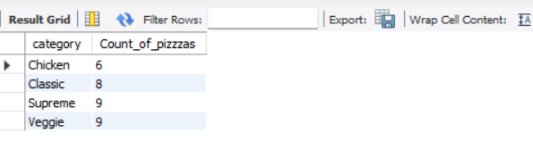
Q8. Join relevant tables to find the category-wise distribution of pizzas.
QUERY
OUTPUT

Slide 14
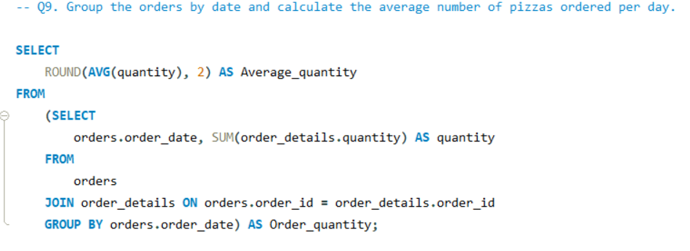
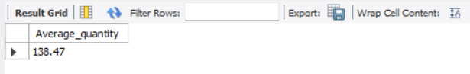
Q9. Group the orders by date and calculate the average number of pizzas ordered per day.
QUERY
OUTPUT

Slide 15
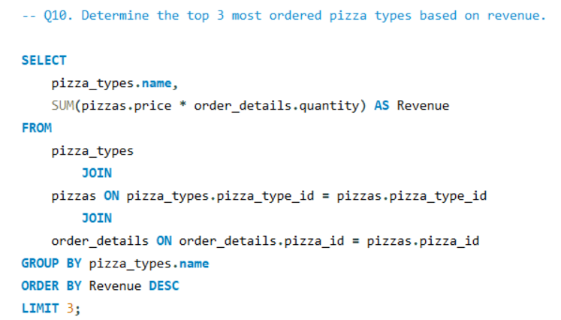
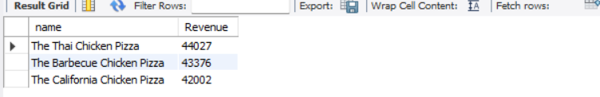
Q10. Determine the top 3 most ordered pizza types based on revenue.
QUERY
OUTPUT

Slide 16
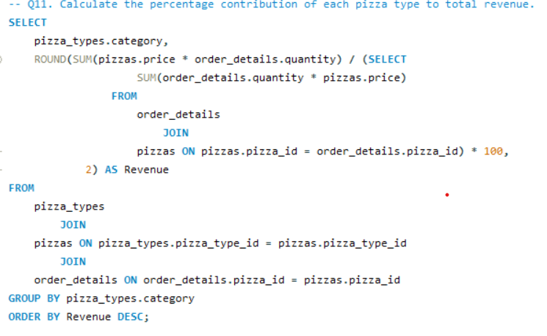
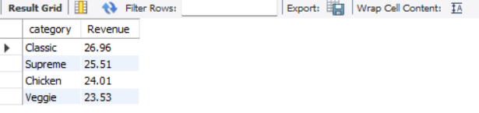
Q11. Calculate the percentage contribution of each pizza category to total revenue.
QUERY
OUTPUT

Slide 17
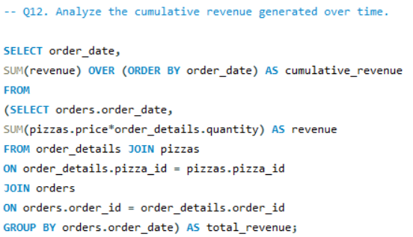
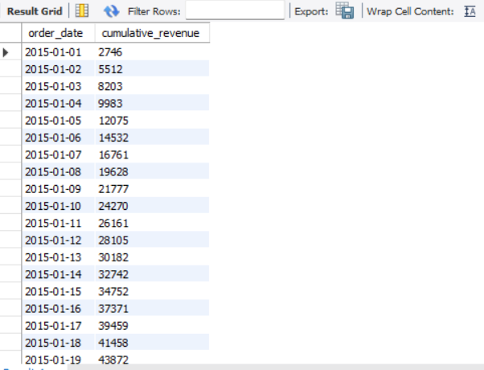
Q12. Analyze the cumulative revenue generated over time.
QUERY
OUTPUT

Slide 18
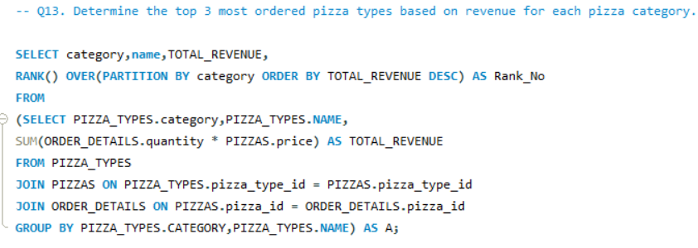
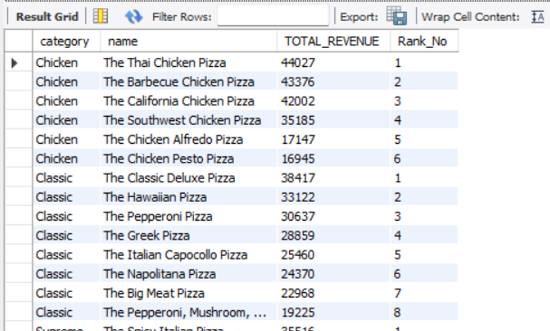
Q13. Determine the top 3 most ordered pizza types based on revenue for each pizza category.
QUERY
OUTPUT

Slide 19

CONCLUSION
Pizza Sales Analysis project provided valuable insights into the operational and customer dynamics of the pizza business. Here's a concise conclusion with advice for future action.
Order Volume and Revenue: With a total of 21,350 orders and $827,450 in revenue, the business is experiencing strong demand.
Product Mix: The Greek Pizza is the most expensive pizza, indicating a premium segment, while the most common size is large, which might suggest a preference for family or group orders. The top 5 most ordered pizzas cover a range of classic and specialty types, indicating a diverse customer base.
Customer Behavior: The busiest ordering times are from 16:00 to 19:00, pointing to high demand during dinner hours. The Thai Chicken pizza leads in the number of orders per day.
Revenue Contribution: Classic and Supreme pizzas make up the largest share of revenue, followed closely by Chicken and Veggie pizzas, suggesting a balanced distribution of customer preferences.

Slide 20

ADVICE FOR FUTURE ACTION
Optimize Operations During Peak Hours: Given the high volume of orders between 16:00 and 19:00, ensure adequate staffing and resources to handle this busy period. Consider special promotions or bundle deals to encourage off-peak sales.
Expand Popular Offerings: Focus marketing efforts on the top 5 most ordered pizzas, while also experimenting with new flavors or promotions to attract a broader audience.
Revenue Diversification: With Classic and Supreme pizzas contributing the most to revenue, keep these categories strong, but explore other pizza types to ensure sustained growth and customer interest.
Data-Driven Decision Making: Continuously monitor sales data to identify trends and customer preferences. This will allow for proactive adjustments to the menu, pricing, and promotions to maximize revenue and customer satisfaction.

Slide 21
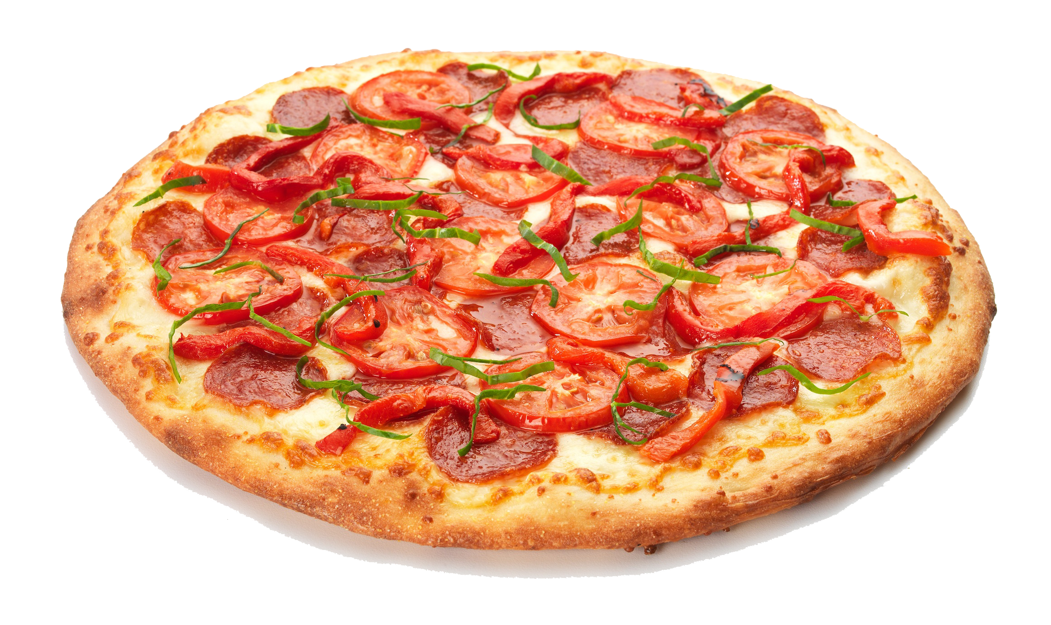
THANK YOU
Thank you for your attention and participation. I appreciate your time and interest in our Pizza Sales Analysis project.
If you have any further questions, feedback, or suggestions, please don't hesitate to reach out. Your insights and comments are valuable to us as we continue to refine and improve our analysis.
Thank you, and have a great day!

